Slide 1

An ecosystem-science approach to support salmon management: How ocean sampling can help modeling efforts
Brian K. Wells^{1,2}, Nate J. Mantua¹, Brain J. Burke³, and Jerome Feichter⁴
1. Southwest Fisheries Science Center, National Marine Fisheries Service, National Oceanic and Atmospheric Administration, Santa Cruz, CA, United States, brian.wells@noaa.gov
2. Northwest Fisheries Science Center, National Marine Fisheries Service, National Oceanic and Atmospheric Administration, Newport, OR, United States
3. Northwest Fisheries Science Center, National Marine Fisheries Service, National Oceanic and Atmospheric Administration, Seattle, WA, United States
4. Department of Ocean Sciences, University of California at Santa Cruz, Santa Cruz, CA, United States

Slide 2
How ocean sampling can help modeling efforts
Conceptual models representing the contemporary understanding of the ecosystem
Improving understanding of salmon behavior, growth, and mortality rates at sea,
Improve salmon assessment models based on research of ecosystem processes,
Life-cycle models to evaluate tradeoffs associated with management alternatives.
Looking to the future

Slide 3
How ocean sampling can help modeling efforts
Conceptual models representing the contemporary understanding of the ecosystem
Improving understanding of salmon behavior, growth, and mortality rates at sea,
Improve salmon assessment models based on research of ecosystem processes,
Life-cycle models to evaluate tradeoffs associated with management alternatives.
Looking to the future

Slide 4
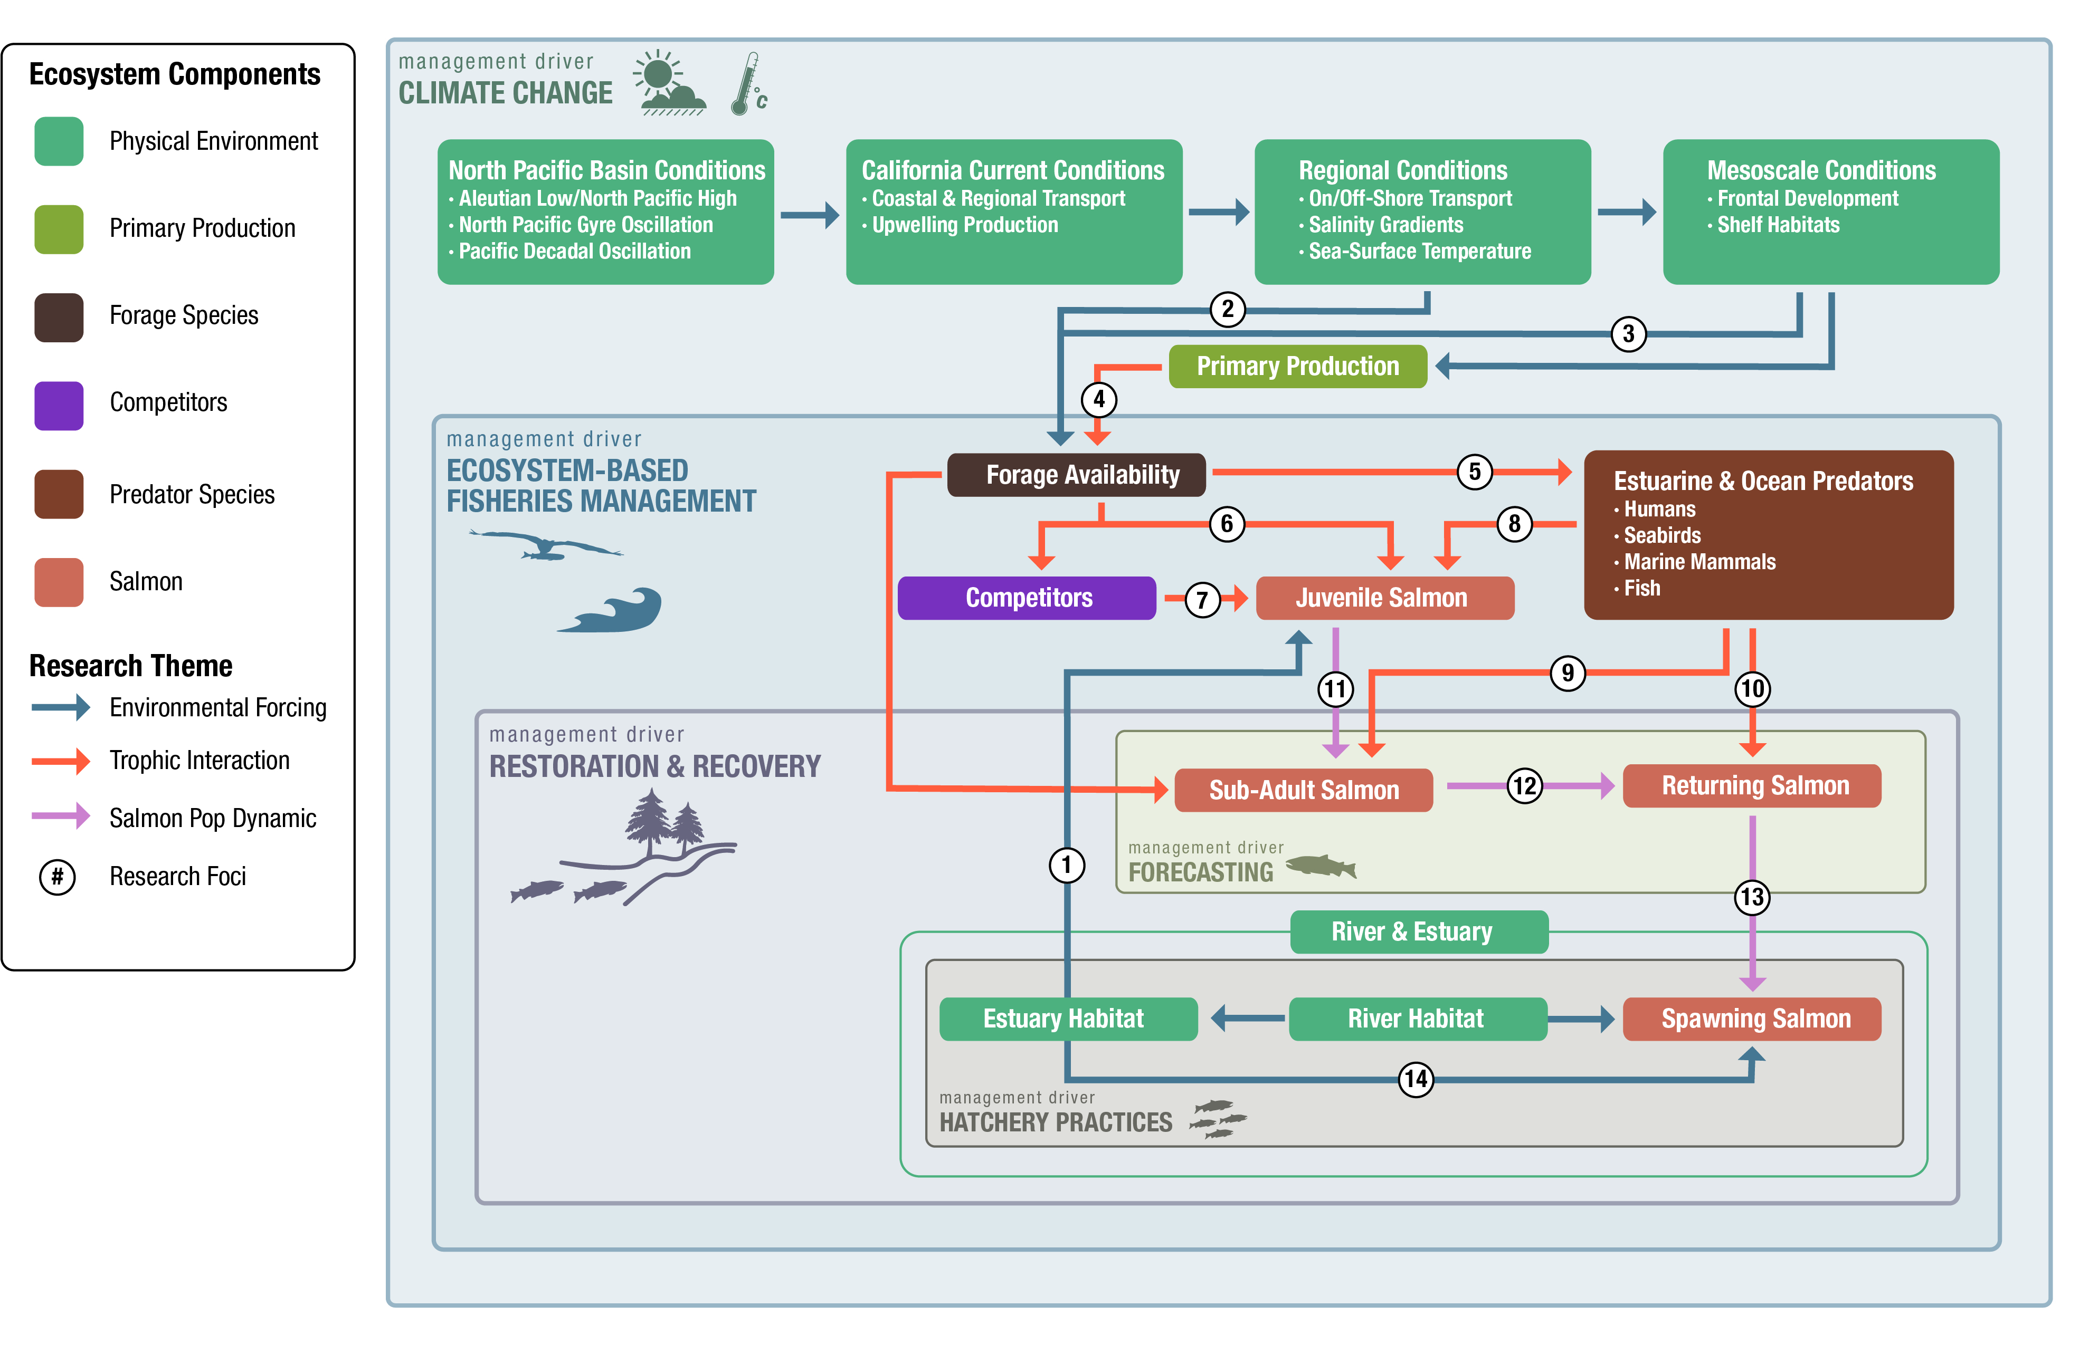
Designing purpose-built conceptual models

Slide 5
Designing purpose-built conceptual models

Slide 6
How ocean sampling can help modeling efforts
Conceptual models representing the contemporary understanding of the ecosystem
Improving understanding of salmon behavior, growth, and mortality rates at sea,
Improve salmon assessment models based on research of ecosystem processes,
Life-cycle models to evaluate tradeoffs associated with management alternatives.
Looking to the future

Slide 7
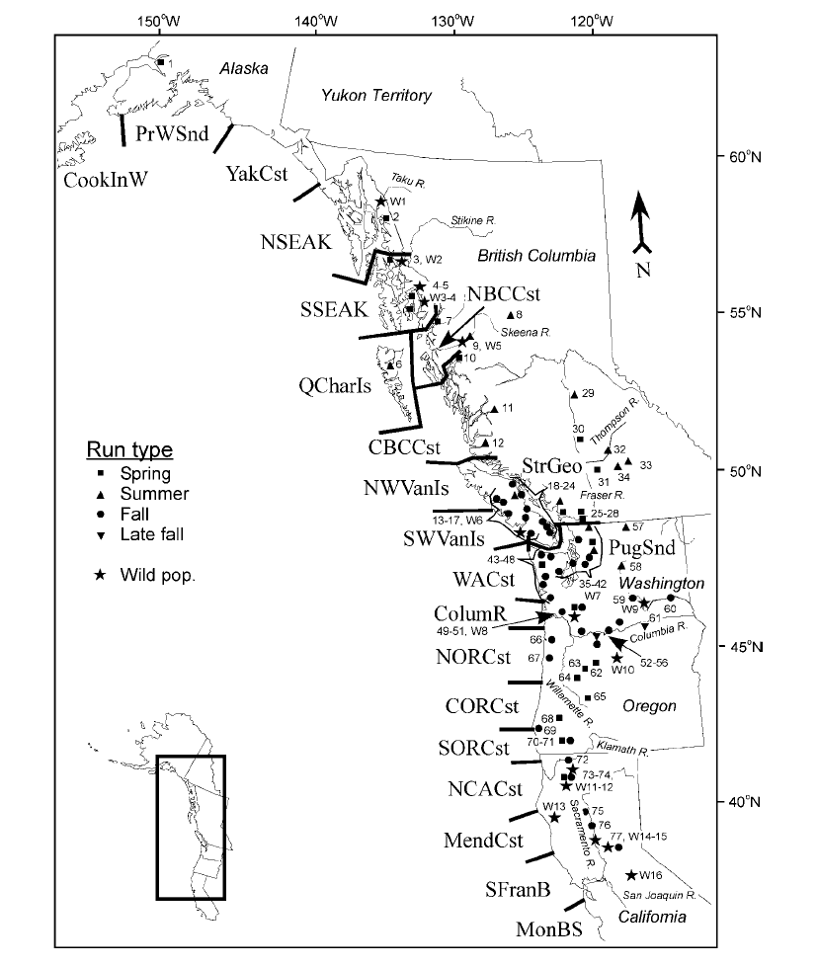
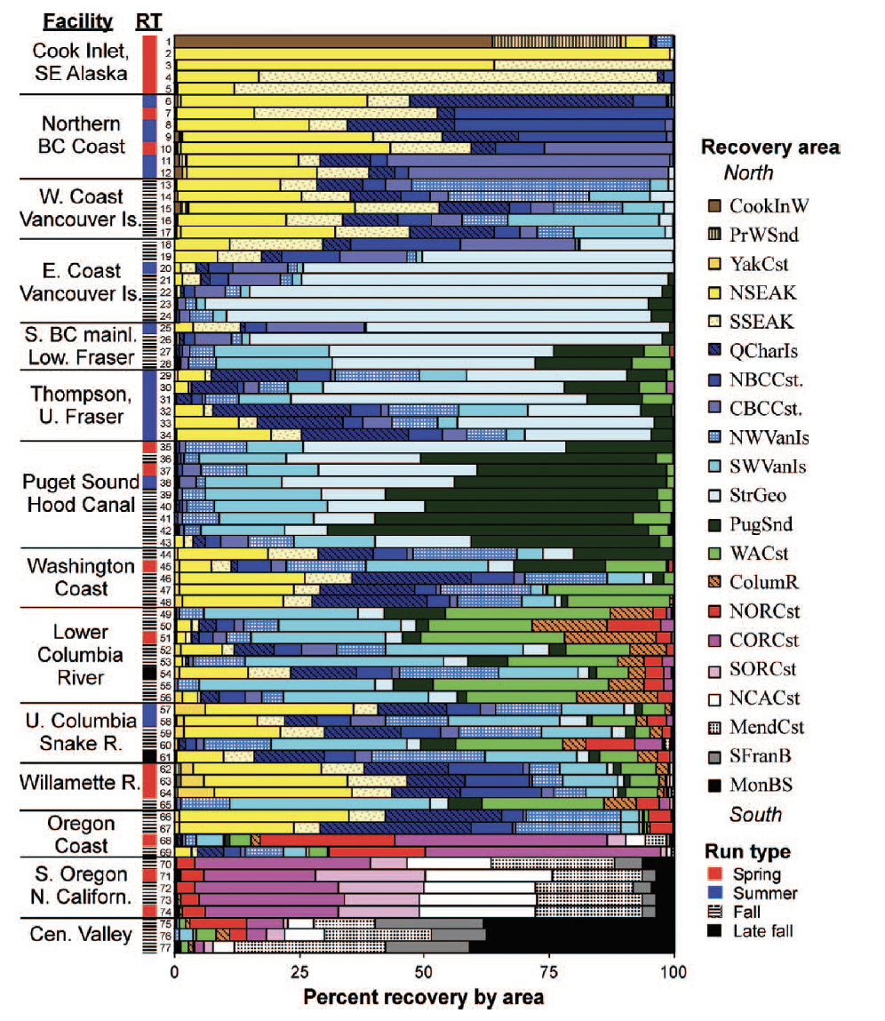
2) Improving our understanding of salmon at sea
As the fish age through their life cycle we need to consider their distributions
Tagging studies and spatiotemporally expanded survey efforts can be used to address this.
Weitkamp 2010

Slide 8
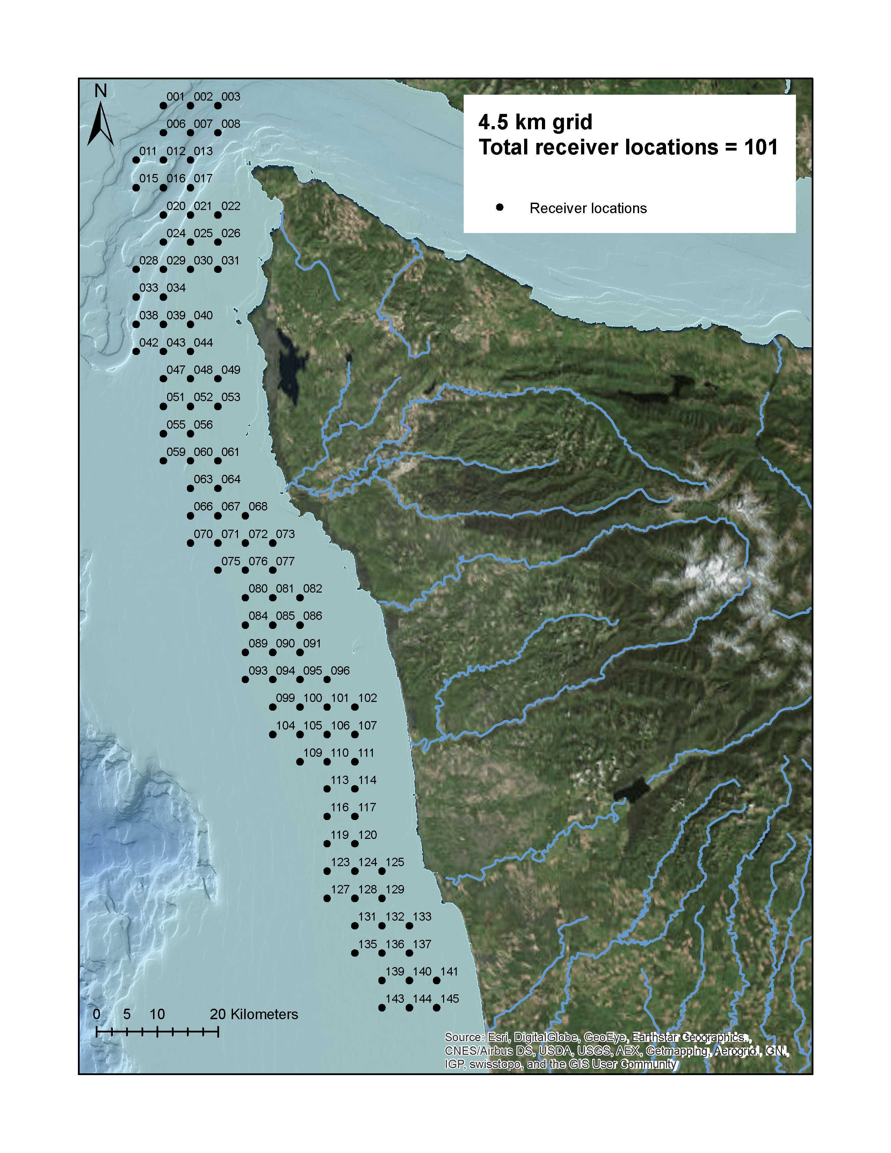
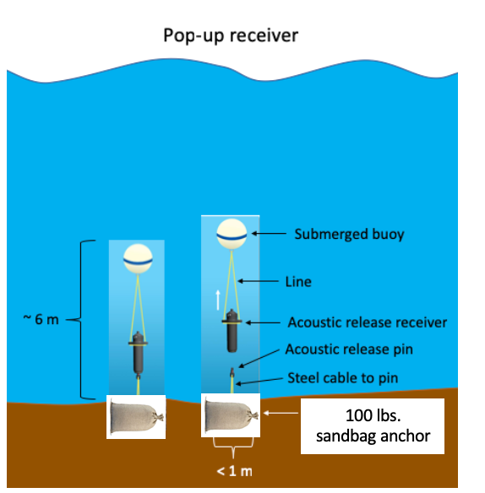
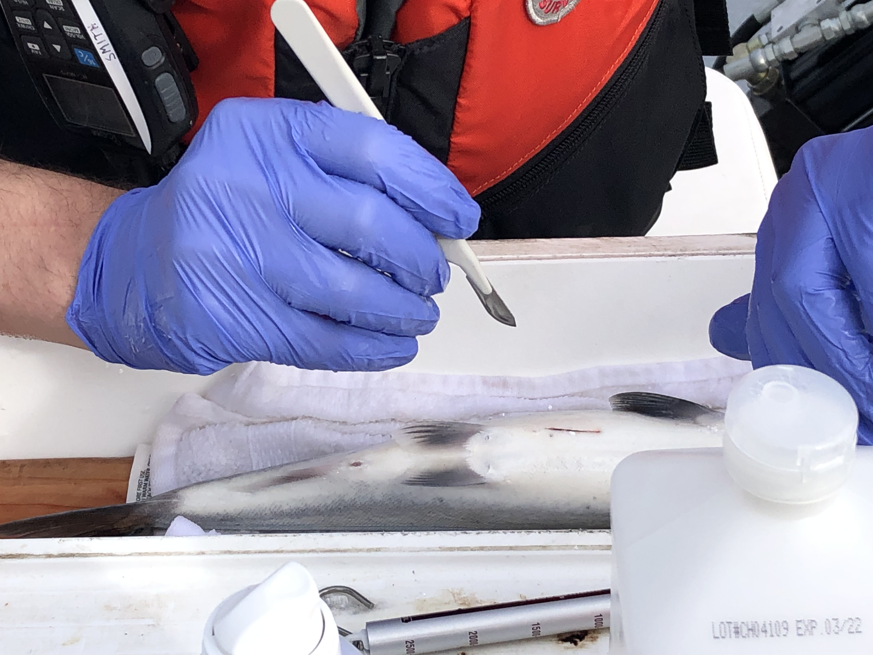
2) Improving our understanding of salmon at sea
Ocean acoustic arrays can inform behavior
Behavioral studies can inform these models
J. Smith and D. Huff, Salmon Ocean Behavior and Distribution

Slide 9
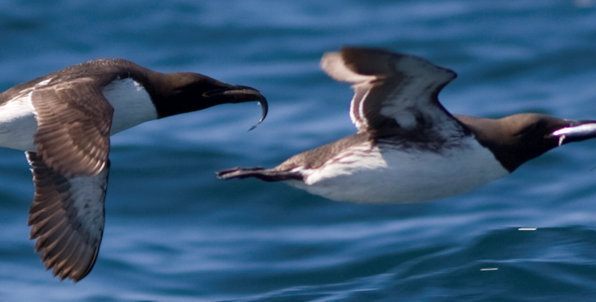
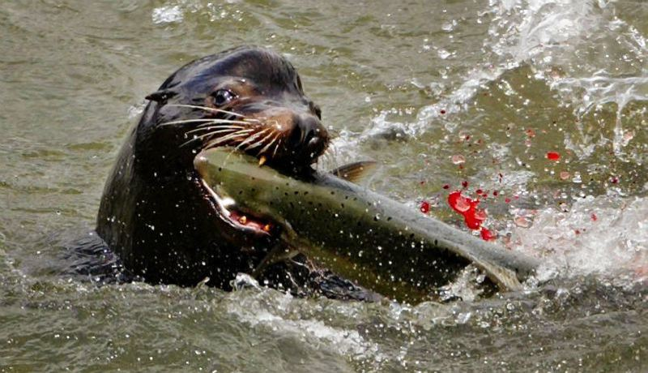
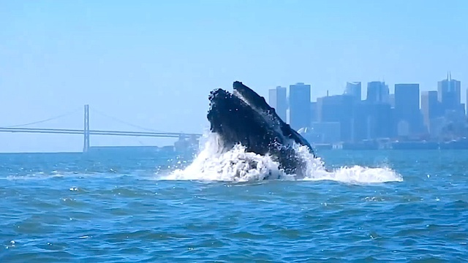
Much of morality at sea is due to predation
EBFM
More process studies need to be conducted to understand the role of predators on salmon mortality.
Wells et al 2017

Slide 10
How ocean sampling can help modeling efforts
Conceptual models representing the contemporary understanding of the ecosystem
Improving understanding of salmon behavior, growth, and mortality rates at sea,
Improve salmon assessment models based on research of ecosystem processes,
Life-cycle models to evaluate tradeoffs associated with management alternatives.
Looking to the future

Slide 11
3) Improvements to salmon assessment models
Harvestable adults at sea = # of jacks returning
This assumes constant maturation and natural mortality rates – Solution: Ocean sampling of older fish.

Slide 12
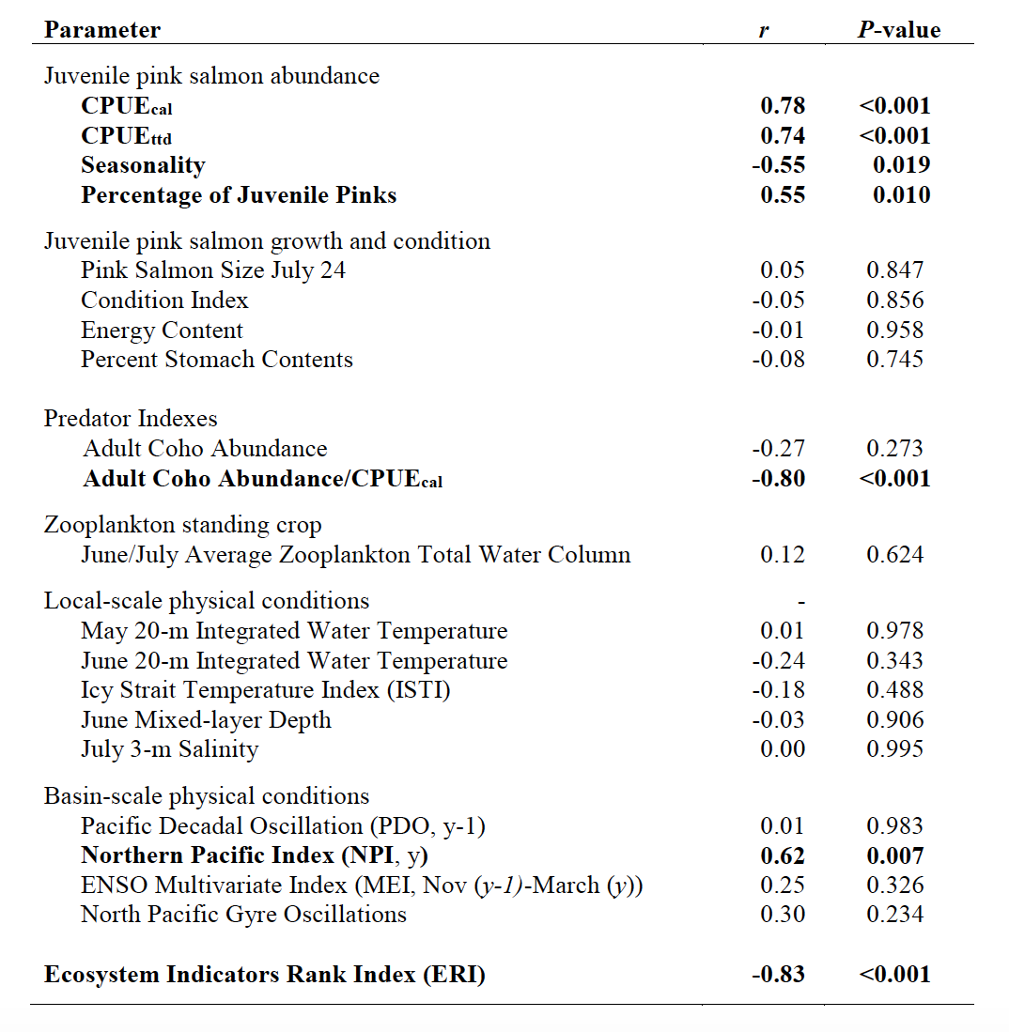
3) Improvements to salmon assessment models
Pink salmon assessments are exploring inclusion of ocean processes
Namely, ocean abundance is estimated from juvenile at-sea CPUE in the context of assumed environmental relationships to mortality. As well, at-sea abundance of predators is included
Harvest = Ln(CPUE juvs) + env1 + env2 +…env_{n}
Wertheimer et al 2017

Slide 13
How ocean sampling can help modeling efforts
Conceptual models representing the contemporary understanding of the ecosystem
Improving understanding of salmon behavior, growth, and mortality rates at sea,
Improve salmon assessment models based on research of ecosystem processes,
Life-cycle models to evaluate tradeoffs associated with management alternatives.
Looking to the future

Slide 14
4) Development of life-cycle models to evaluate tradeoffs
Friedman et al. 2019

Slide 15
4) Development of life-cycle models to evaluate tradeoffs
Carry-over effects (e.g., size at emigration, timing, diversity) are directly related to freshwater experiences and relate to survival and maturation at sea. These are levers in our control. Can be studied with early sampling and hatchery manipulations.

Slide 16
4) Development of life-cycle models to evaluate tradeoffs
Carry-over effects (e.g., size at emigration, timing, diversity) are directly related to freshwater experiences and relate to survival and maturation at sea. These are levers in our control. Can be studied with early sampling and hatchery manipulations.
Life-history transitions are dependent on entry demographics, ocean conditions, and selective predation. Ocean surveys of older fish provide parameterization

Slide 17
4) Development of life-cycle models to evaluate tradeoffs
Successful spawning depends on return dynamics and freshwater habitat. The ocean has influence on age and timing of spawning and can inform habitat management. Sampling fish on return can be used here.
Carry-over effects (e.g., size at emigration, timing, diversity) are directly related to freshwater experiences and relate to survival and maturation at sea. These are levers in our control. Can be studied with early sampling and hatchery manipulations.
Life-history transitions are dependent on entry demographics, ocean conditions, and selective predation. Ocean surveys of older fish provide parameterization provide parameterization

Slide 18
4) Development of life-cycle models to evaluate tradeoffs
The key is that ocean influences (e.g., predation) were parameterized in the context of all examined influences across the full life cycle. Therefore, any managerial decisions considered, such as flow-dependent emigration size or timing, can be evaluated properly in the context of predation at sea.
Friedman et al. 2019

Slide 19
How ocean sampling can help modeling efforts
Conceptual models representing the contemporary understanding of the ecosystem
Improving understanding of salmon behavior, growth, and mortality rates at sea,
Improve salmon assessment models based on research of ecosystem processes,
Life-cycle models to evaluate tradeoffs associated with management alternatives.
Looking to the future

Slide 20
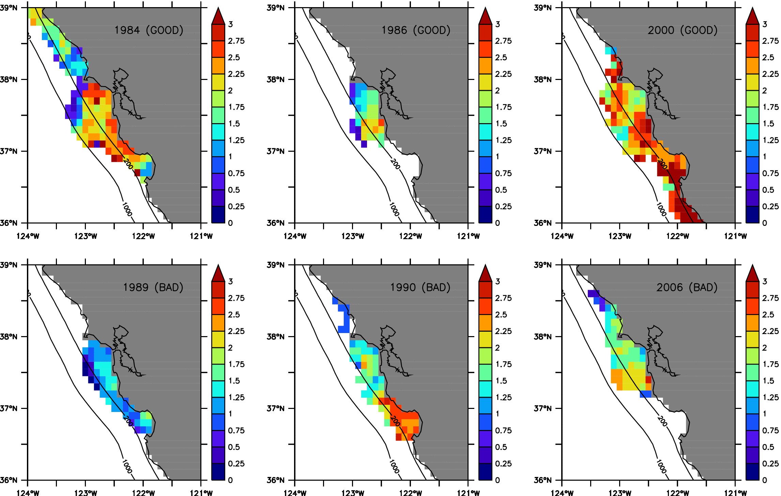
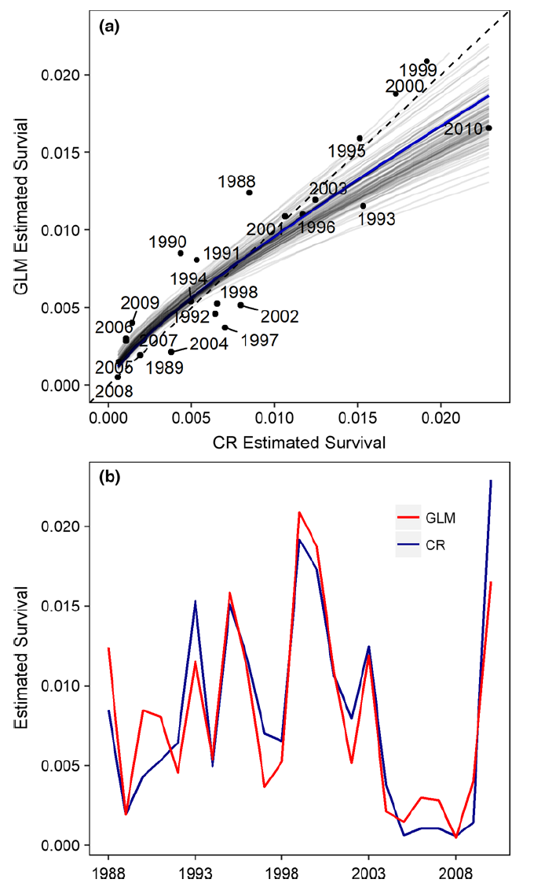
5) Looking to the future
Years of good survival
Survey data is used to parameterize ecosystem-level models where there is need to incorporate behavior, distribution, prey dynamics and ocean state.
To the left is modeled growth of salmon at sea in different ocean states and to the right is modeled early survival related to growth
Years of poor survival
Fiechter et al. 2015
Henderson et al. 2018

Slide 21
How ocean sampling can help modeling efforts
Designing purpose-built conceptual models can guide research and management
Salmon dynamics after early ocean entry are poorly understood
Improved understanding of at-sea dynamics could improve assessments,
Life-cycle models can be used to evaluate additive and cumulative effects across life
To rebuild stocks we need simulation approaches that incorporate and allow discovery of processes.

